Slide 1
COVID-19:
Wealth and Risk
Anita Adams, Randy Geszvain and Michael O’Keefe
7 June 2020
IST 707

Slide 2
1.
Introduction

Slide 3
Wealth Gap
Is economic status and its related variables a predictor of coronavirus...
confirmed case growth over two weeks?
death growth over two weeks?
per capita confirmed cases
death rate per confirmed case?

Slide 4
2.
EDA
Initial Results

Slide 5
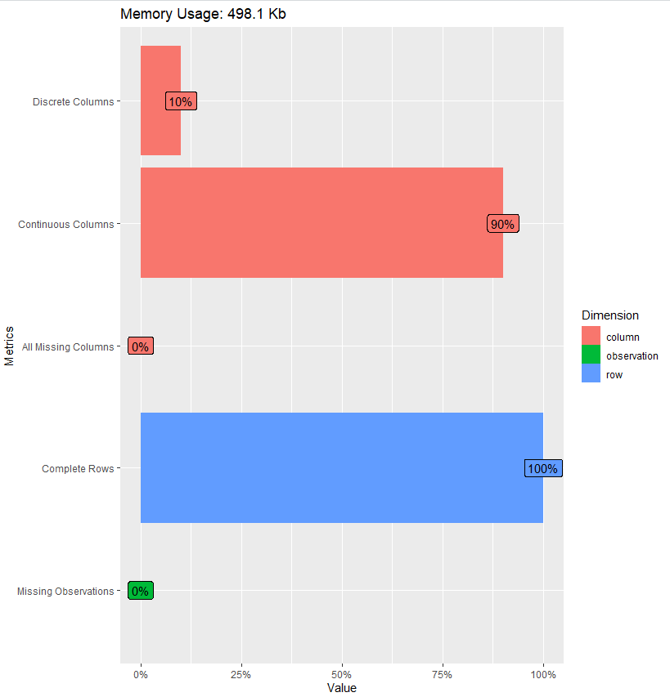
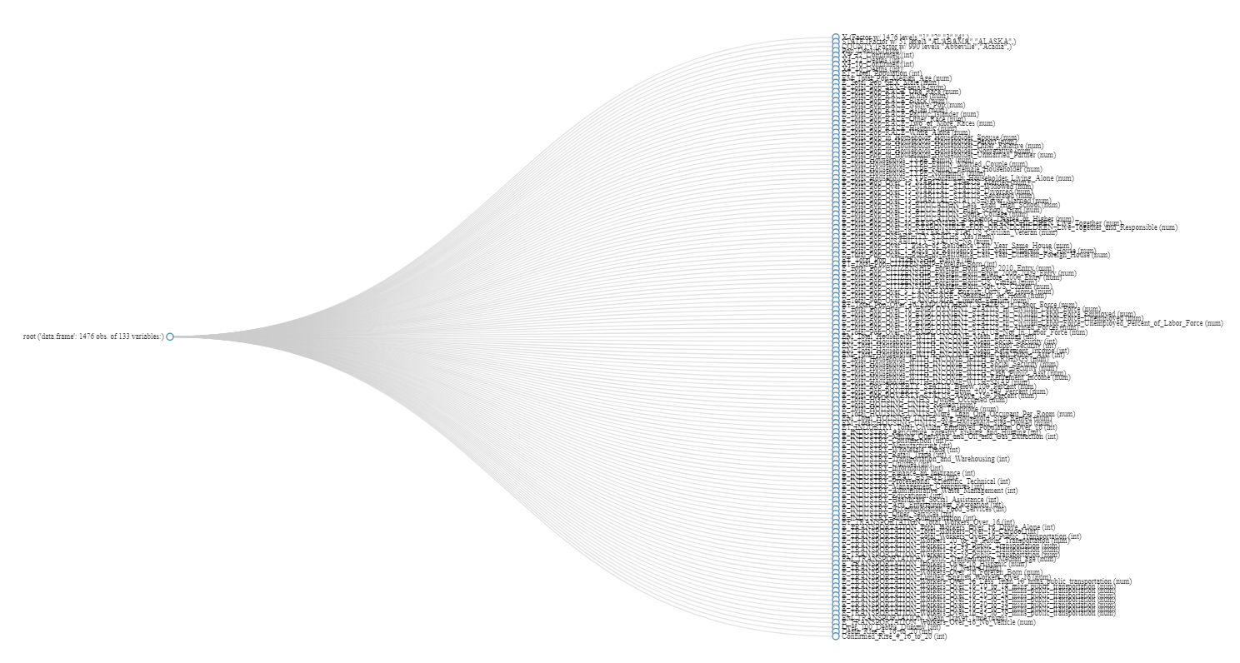
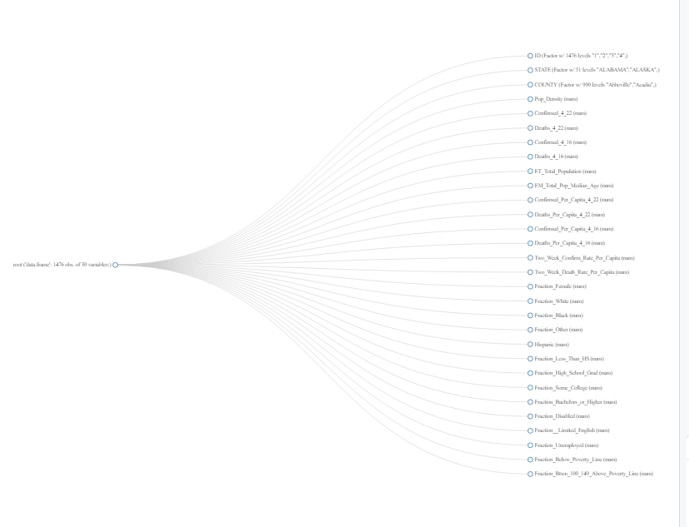
New Data Set Visually
Before
After

Slide 6
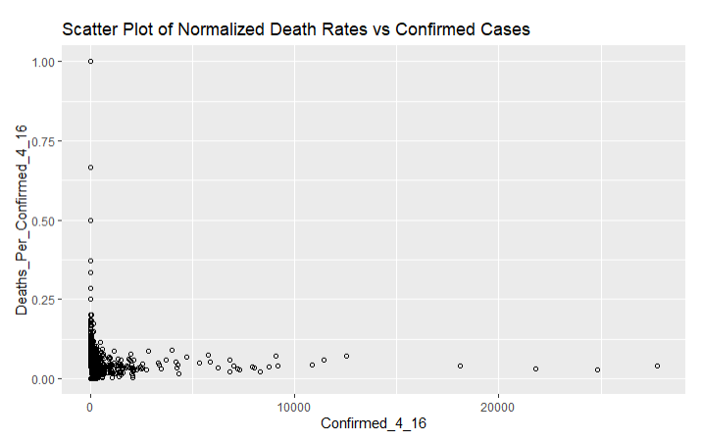
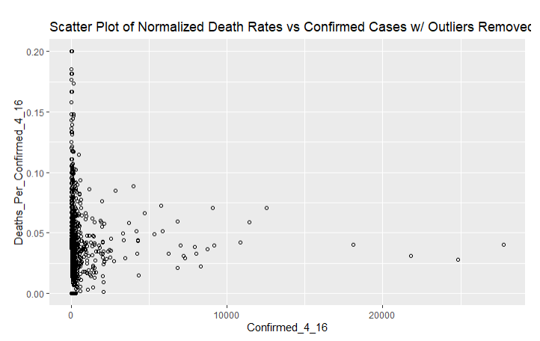
Outliers in the Data When Number of Cases is Very Small
14 data points with Zscores > 3 were removed

Slide 7
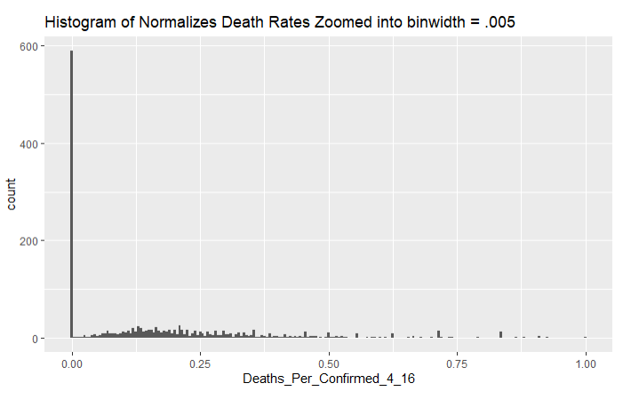
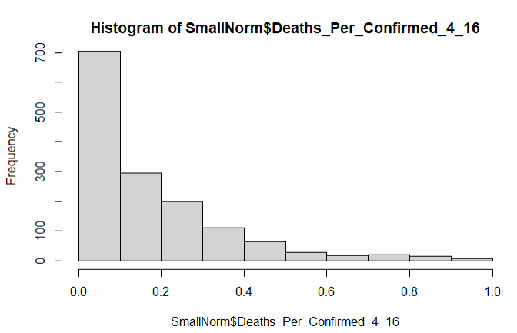
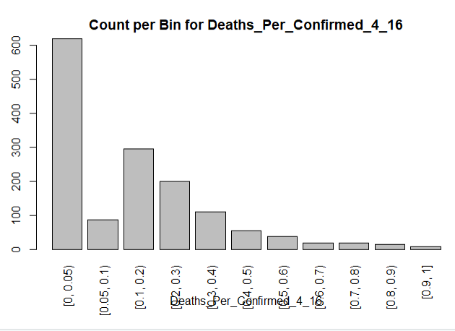
Discretization
Very many data points where the death rate is very low - these warrant their own bin
Other variables discretized (as needed) using 10 evenly distributed bins

Slide 8
3.
Models

Slide 9
Classification

Slide 10
Can Deaths Per COVID Case Be Predicted by Wealth Indicators?
The following algorithms from function “train” in package “caret” were applied and tuned using k-fold validation:
Naive Bayesian
K Nearest Neighbor (KNN)
Random Forest
Support Vector Machine (kernel - Linear)
Support Vector Machine (kernel - Radial Basis Function)

Slide 11
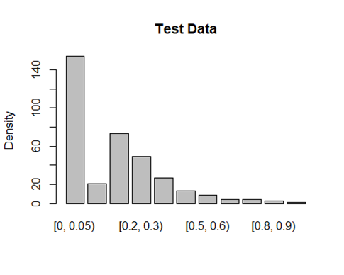
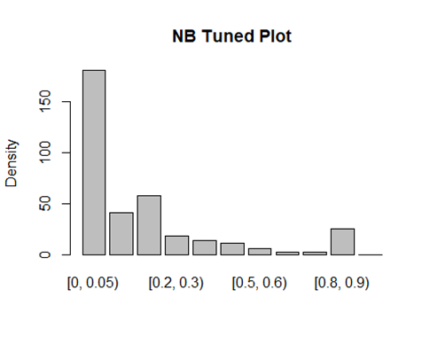
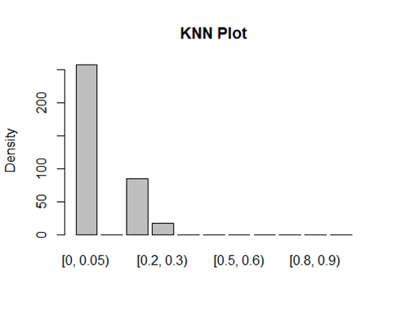
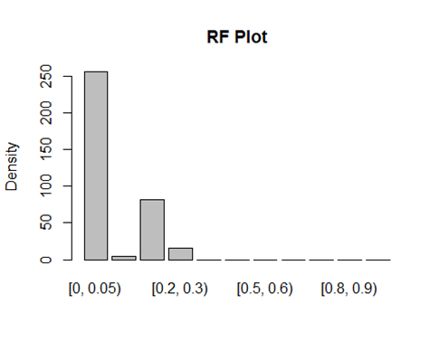
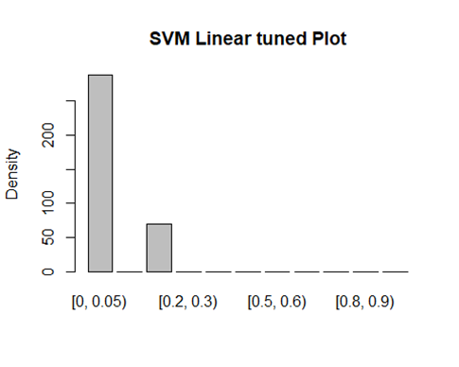
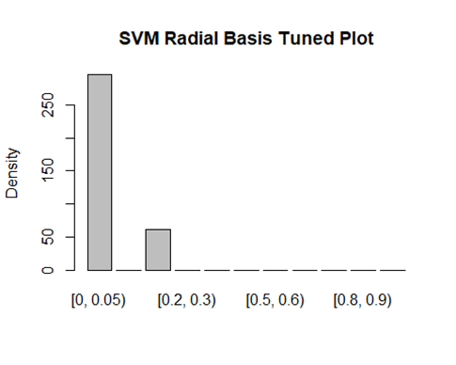
Model Results

Slide 12
Models With Base Data Set
 | Accuracy (Test/Train) | Kappa (Test/Train) | Tuning | Observations
NB | 39% / 44% | 17% / 14% | Laplace | Predicts values for most bins Variables are not independent
KNN | 47% / 49% | 18% / 20% | K | Most predictions in Bin1 w/ a few in Bin3 and Bin4
RF | 49% / 54% | 23% / 27% | mtry* | Like KNN but even stronger bias to Bin1
SVM- Linear | 49% / 53% | 18% / 23% | c | Only selects Bin1 and Bin3
SVM - RBF | 48% / 51% | 16% / 20% | sigma | Only selects Bin1 and Bin3
* Mtry : Number of variables randomly sampled as candidates at each split

Slide 13
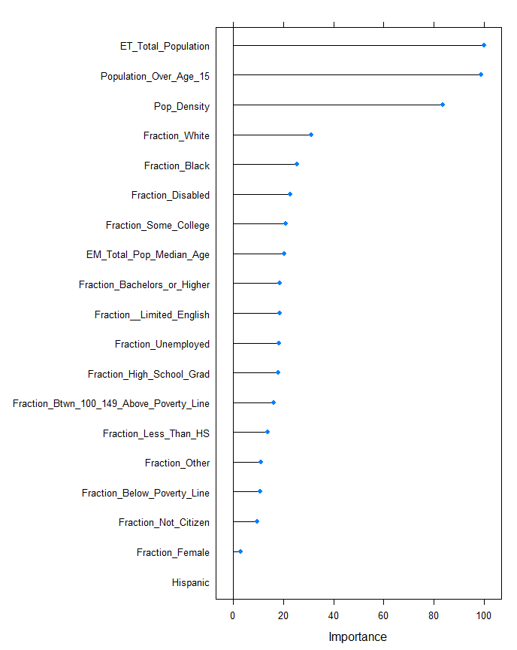
Variable Importance for RF
Total Population, Size of Population over 15 (which is strongly correlated to total Population), and Population Density drive the predictions
Race, Disability and Education are more important than Age
Poverty level income, Alien status, Sex are last in importance
Being Hispanic has no predictive importance

Slide 14
Data Set Excursions for RF
The following data set excursions were conducted using the most accurate model (RF)
PCA dimensionality reduction
Take out low death rate / very high instances bin
Don’t normalize fractions
Remove non-wealth variables

Slide 15
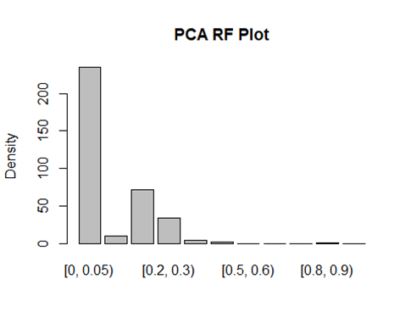
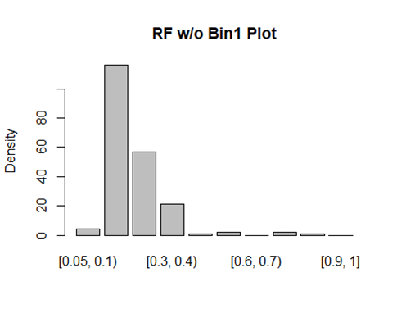
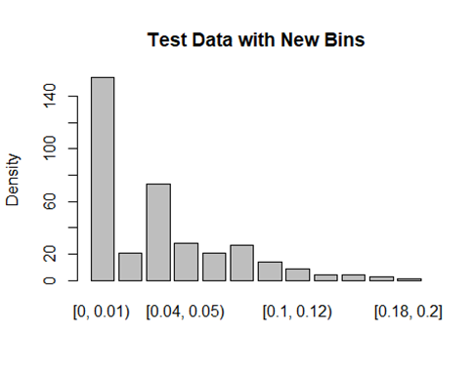
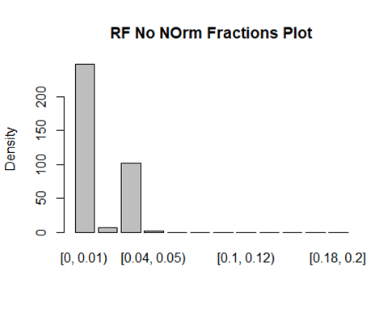
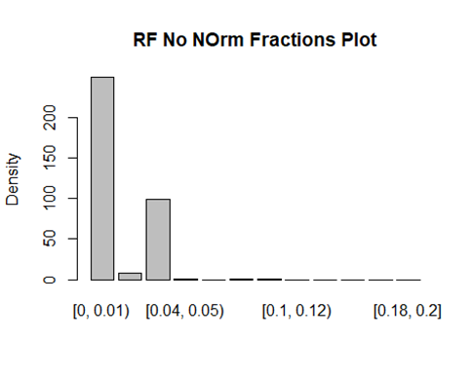
Excursion Model Results
RF Nn Norm Fractions Plot
RF Wealth Data Only

Slide 16
RF Models With Data Set Excursions
 | Accuracy (Test/Train) | Kappa (Test/Train) | Observations
RF baseline | 49% / 54% | 23% / 27% | Even stronger bias to Bin1 than KNN
PCA | 47% / 49% | 21% / 23% | Lower accuracy but much better distribution
Remove Bin1 | 30% / 38% | 2% / 13% | Lower accuracy - mostly due to chance
No Norm of Fractions | 49% / 52% | 21% / 25% | Does not materially impact answer
Remove Non-Wealth Variables | 48% / 53% | 21% / 28% | Mostly Bin1 and Bin3

Slide 17
Cluster Analysis

Slide 18
Do counties with high mortality rates share characteristics?
Packages “factoextra” and “stats” were used to perform k-means clustering on data:
Optimal number of clusters calculated with fviz
Nstart set to 25 for stable results
Clusters assignments paired with respective counties
Mean of variables computed and aggregated by cluster

Slide 19
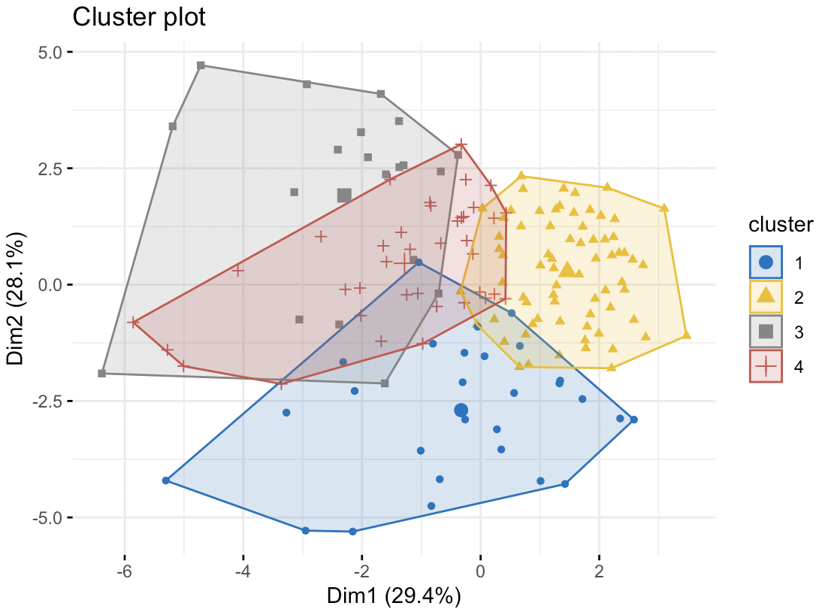
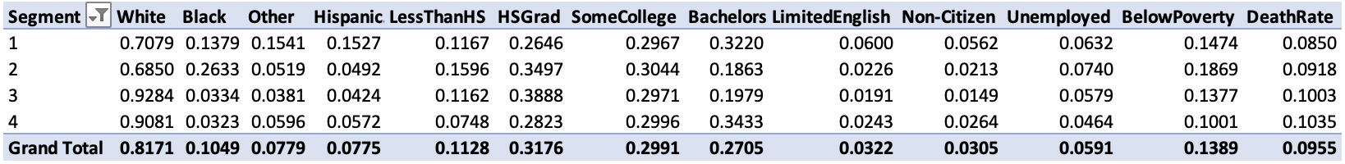
Above Avg. Death Rate Clusters
Counties clustered by above national avg. death rate

Slide 20
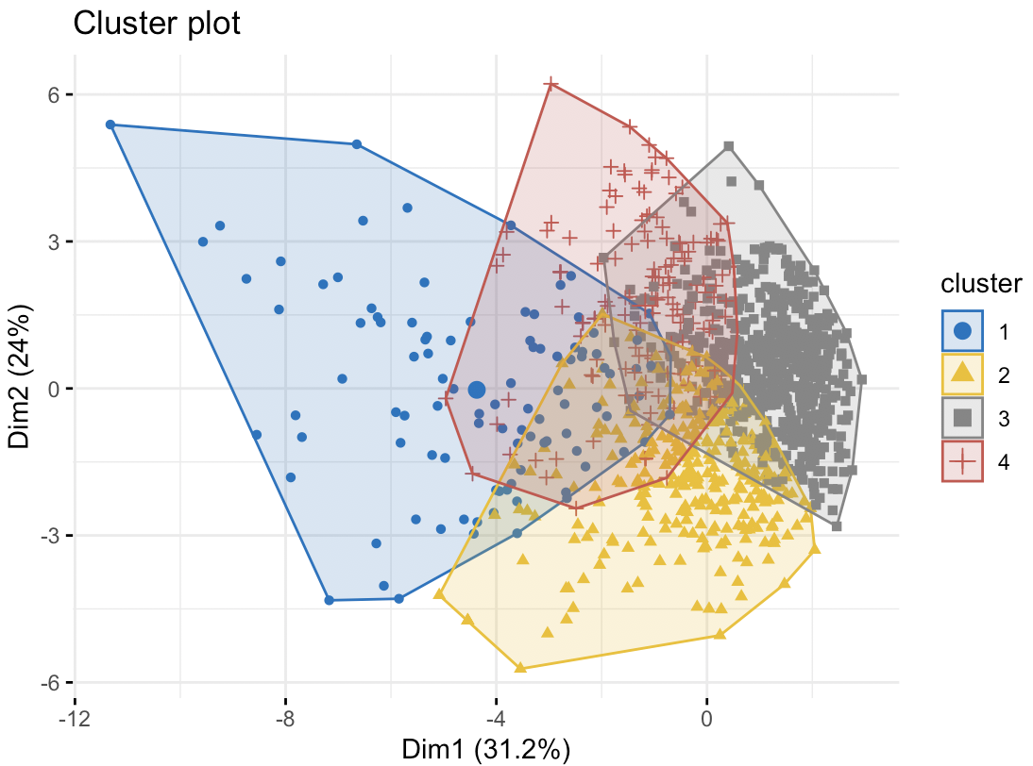
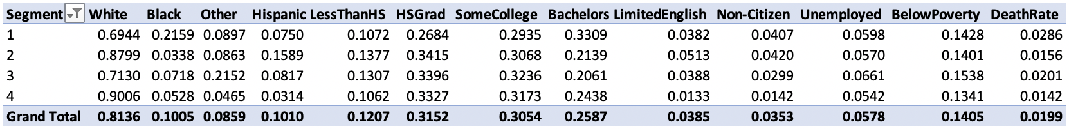
Below Avg. Death Rate Clusters
Counties clustered by below national avg. death rate

Slide 21
Result Observed
Clusters of above national average death rate include
highest poverty rates, avg. 0.1869
lowest fraction of college-educated population of all clusters of counties, avg. 0.1863
highest unemployment rates, avg 0.0740
largest fraction black populations, avg 0.2633
Clusters below national average death rate do not seem to reveal meaningful patterns

Slide 22
Association
Rule
Mining

Slide 23
Measurements
Support measure gives an idea of how frequent an itemset is in all the records.
Confidence measure defines the likeliness of occurrence of consequent in the group given that the group already has the antecedents.
Lift controls for the support (frequency) of consequent while calculating the conditional probability of occurrence of {Y} given {X}. Lift is also the factor by which the co-occurrence of A and B exceeds the expected probability of A and B co-occurring, had they been independent.

Slide 24
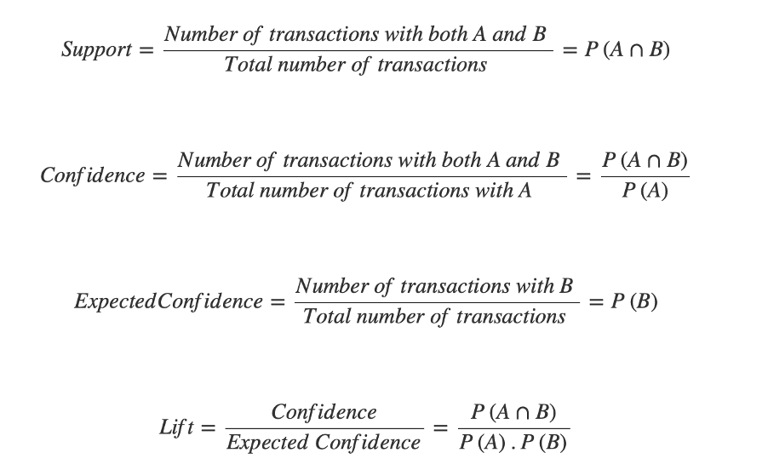
Measurements

Slide 25
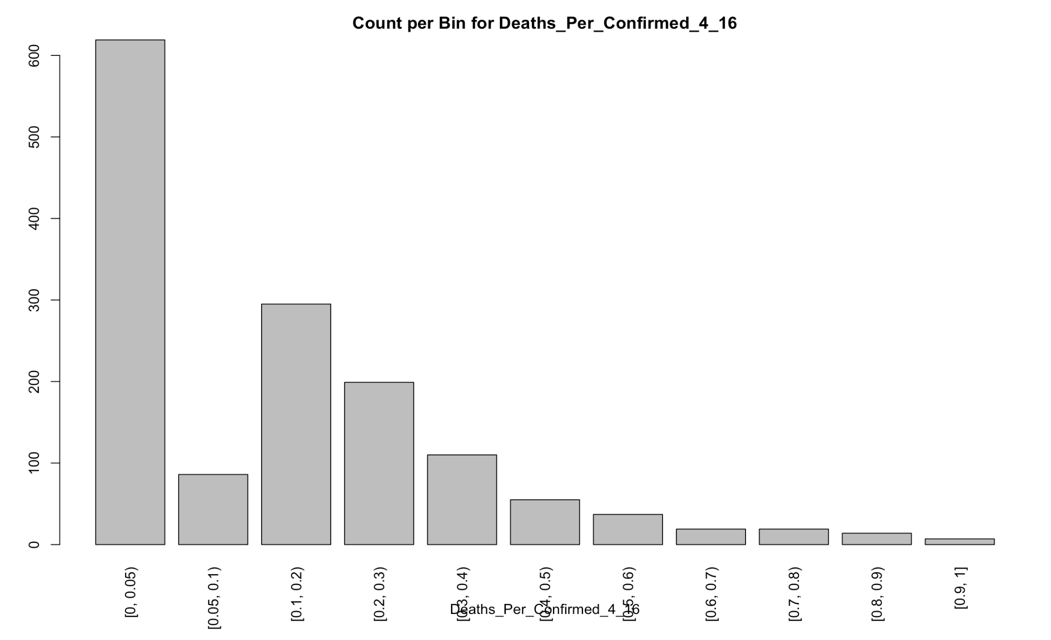

Slide 26
Modeling
Filter: Support: 0.001
Confidence: 0.9
Sort by: Confidence
RHS:
Deaths_Per_Confirmed_4_16

Slide 27
Result Observed
RHS: Deaths_Per_Confirmed_4_16=[0, 0.05)
LHS:
EM_Total_Pop_Median_Age=[0.4, 0.5) Fraction_Female=[0.3, 0.4)}
Fraction_Other=[0.9, 1] Fraction_Below_Poverty_Line=[0.9, 1]
Fraction_Other=[0.9, 1] Fraction_Btwn_100_149_Above_Poverty_Line=[0.7, 0.8)
Fraction_Unemployed=[0.4, 0.5) Fraction_Not_Citizen=[0.8, 0.9)
Fraction_Disabled=[0.3, 0.4) Fraction_Not_Citizen=[0.8, 0.9)

Slide 28
Result Observed
RHS: Deaths_Per_Confirmed_4_16=[0.05, 0.1)
LHS:
Fraction_High_School_Grad=[0, 0.1) Fraction_Some_College=[0.2, 0.3) Fraction_Bachelors_or_Higher=[0.7, 0.8)
Fraction_Other=[0.3, 0.4) Fraction_Btwn_100_149_Above_Poverty_Line=[0.3, 0.4)
Fraction_Other=[0, 0.1) Fraction_Not_Citizen=[0.6, 0.7)
Fraction__Limited_English=[0.4, 0.5) Fraction_Unemployed=[0.2, 0.3) Fraction_Below_Poverty_Line=[0.2, 0.3)

Slide 29
Result Observed
RHS: Deaths_Per_Confirmed_4_16=[0.1, 0.2)
LHS:
Fraction_Bachelors_or_Higher=[0.9, 1]
Pop_Density=[0.6, 0.7),Pop_Density=[0.7, 0.8)
Fraction_White=[0.7, 0.8) Fraction_Bachelors_or_Higher=[0.9, 1]
Fraction_Female=[0.8, 0.9) Fraction_Bachelors_or_Higher=[0.9, 1]
EM_Total_Pop_Median_Age=[0.3, 0.4) Fraction_Bachelors_or_Higher=[0.9, 1]

Slide 30
Result Observed
RHS: Deaths_Per_Confirmed_4_16=[0.2, 0.3)
LHS:
Fraction_White=[0.7, 0.8) Fraction_High_School_Grad=[0.5, 0.6)
Fraction_Other=[0.5, 0.6) Fraction_Below_Poverty_Line=[0.5, 0.6)
Fraction_Other=[0.4, 0.5) Hispanic=[0.4, 0.5)
Fraction_White=[0.4, 0.5) Fraction_Other=[0.4, 0.5)
Hispanic=[0.6, 0.7) Fraction_Not_Citizen=[0.6, 0.7)

Slide 31
Result Observed
RHS: Deaths_Per_Confirmed_4_16=[0.3, 0.4)
LHS:
Fraction_White=[0.6, 0.7) Hispanic=[0.5, 0.6) Fraction_Unemployed=[0.4, 0.5)
Fraction_White=[0.6, 0.7) Fraction_Black=[0, 0.1) Hispanic=[0.5, 0.6)
Fraction_Disabled=[0.5, 0.6) Fraction_Below_Poverty_Line=[0.5, 0.6) Fraction_Btwn_100_149_Above_Poverty_Line=[0.8, 0.9)
Fraction_White=[0.6, 0.7) Fraction_Other=[0.3, 0.4) Fraction_Not_Citizen=[0.5, 0.6)

Slide 32
Result Observed
RHS: Deaths_Per_Confirmed_4_16=[0.4, 0.5)
LHS:
Fraction_Female=[0.7, 0.8) Fraction_Btwn_100_149_Above_Poverty_Line=[0.7, 0.8) Fraction_Not_Citizen=[0.5, 0.6)
Fraction_White=[0.5, 0.6) Fraction_Unemployed=[0.4, 0.5) Fraction_Btwn_100_149_Above_Poverty_Line=[0.7, 0.8)
Fraction_Female=[0.7, 0.8) Fraction__Limited_English=[0.3, 0.4) Fraction_Btwn_100_149_Above_Poverty_Line=[0.7, 0.8) Fraction_Not_Citizen=[0.5, 0.6)

Slide 33
Result Observed
We only observed the relationship between death per confirmed rate and different demographic groups.
LIFT value goes up as the deaths per confirmed rate goes up.
As the deaths per confirmed rate grew, we saw more and more random relationships in the result. However, one indicator stuck out was the “wealthiness.”

Slide 34
4.
Conclusions

Slide 35
Is Wealth an Indicator of COVID Deaths per Confirmed Cases?
Indicators of poverty may be associated with higher death rates
income below poverty line, lack of college-education, unemployment, and black populations
Income above the poverty line may be associated with lower death rates
However, we cannot predict death rates based on the chosen demographics with much accuracy

Slide 36
Why or Why Not?
Why : Known COVID risk factors may also be associated with poverty:
Underlying health issues may also be correlated with poverty (diabetes, heart disease, pulmonary disease, etc.)
Lack of access to health care
Crowded living quarters
Use of public transportation
Essential low-paying jobs
Why Not:
Effective COVID treatment is not understood so deaths may be independent of wealth
It may be that acquisition of COVID is associated with wealth

Slide 37
Recommendations for Further Analysis
For Death Rate Per Confirmed Case as “y”
Construct data set where variables are less dependent (e.g., only include non-white vs white, black and other)
Try PCA for other models and data set excursions
Try zip codes which provide more demographic granularity than county
Try patient demographic data (anonymized for HIPAA)
Get more current data
Try different “y”
COVID acquisition instead of death rate

Slide 38
Questions?

Slide 39
Slides from First Presentation

Slide 40
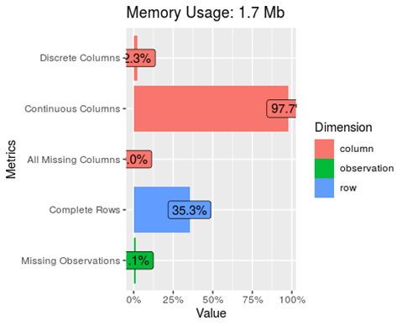
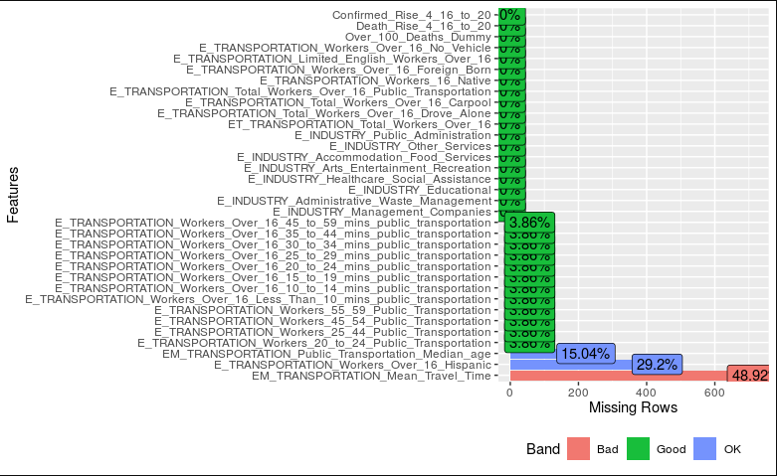
Missing Data / NAs
35% of the row data is missing
Missing data is concentrated in transportation data

Slide 41
Reduce Dimensionality
Variable Removed | Rationale
Industry | Not fine grained enough to reflect essential services
Housing Units | Correlated with Poverty Status which is retained
Income source | Correlated with Poverty Status which is retained
Household Composition | Not an indicator of wealth
Marital Status | Not an indicator of wealth
Grandchildren in home | Not an indicator of wealth
Veteran Status | Not an indicator of wealth
Moved last year | Not an indicator of wealth
Transportation | Too much missing data

Slide 42
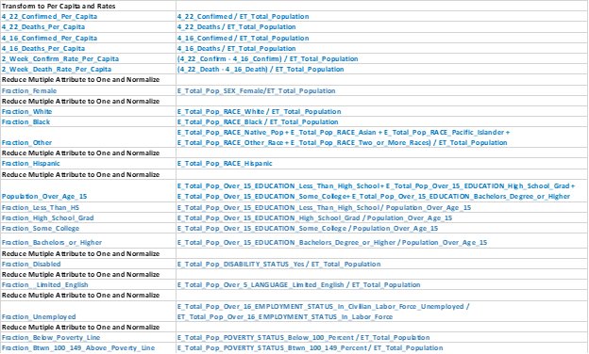
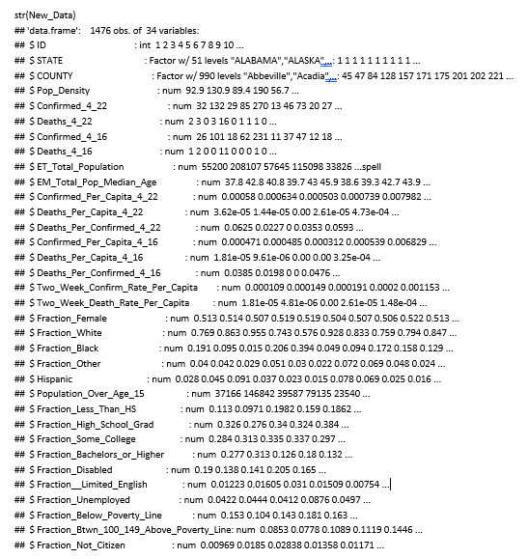
Transform and Normalize the Data

